Slide 1




Healthcare Patient Safety
Team 3 - Emmanuel, Dao, Anish, Manaswini, Pamela

Slide 2
Introduction
Who, When, Why, Where
Literature Review
Input
Methodology
Output
Results
Discussion
Limitations
Future Studies
In this Presentation

Slide 3
INTRODUCTION
Hospital Efficiency Analysis: Evaluating how well hospitals convert resources utilized (inputs) into patient care results (outputs). The goal is to determine what organizations best offer top-notch medical treatment using the available resources! To achieve this, we will use Data Envelopment Analysis to determine the efficiency.

Slide 4
WHO IS AFFECTED?
Patients: Inefficiencies can lead to longer wait times, delayed treatments, and suboptimal care.
Healthcare Providers: Inefficiencies can increase workload and job stress, and lawsuits in extreme cases.
Hospitals: Inefficiencies can impact financial performance and reputation.
Policymakers and payers

Slide 5
WHEN SHOULD THIS BE DONE?
Continuous monitoring and improvement efforts are crucial to maintain high levels of efficiency.
Regular assessments and data analysis can help identify areas for improvement.

Slide 6
WHY IS DEA IMPORTANT?
Can perform comprehensive efficiency evaluation of hospitals to measure relative efficiency of decision-making units (DMUs) within a healthcare system.
Can handle multiple inputs and outputs simultaneously.
Does not require predetermined assumptions about relationships between inputs and outputs
Hospital efficiency evaluation
Hospitals can improve overall performance by identifying and addressing inefficiencies.

Slide 7
WHERE WAS THE DATA FOUND?
  The data was found on the following link: https://data.cms.gov/
  Within this link, we were able to narrow down our options of focus by both subject and time-period. We will be focusing on hospital efficiency for the year 2021 and will be focusing on the State Level.
  We will be choosing inputs from the dataset to determine the efficiency of the hospitals in Oregon.

Slide 8
LITERATURE REVIEW
  Objective: Evaluate hospital efficiency by analyzing resource utilization and patient care delivery, contributing to cost-effective, high-quality healthcare.
  Key Studies:
    Friedman & Ruttenberg (1995): Introduced DEA for hospital efficiency.
    Ozcan et al. (2010): Examined trade-offs between efficiency, quality, and cost.
    Wang et al. (2017): Integrated efficiency, quality, and cost in-hospital evaluation.
  Sources: CMS.gov, AHRQ, AHA.
  Tool: R Studio for DEA-based analysis.
  Focus: 2021 data snapshot for contextual relevance.
  Future Considerations:
    Incorporate care quality and geographic disparities.
    Policy recommendations to enhance efficiency and resource use.

Slide 9
INPUT
Number of Discharges - reflecting the volume of care provided by the hospital.
Predicted Readmission Rate - used to understand the predicted strain on hospital resources.
Notes:
The key factors used in Data Envelopment Analysis (DEA) to assess hospital efficiency are:
Number of Discharges: This metric reflects the volume of care provided by the hospital.
Number of Readmissions: This indicates the quality of care and the hospital's ability to manage patient flow.
Predicted and Expected Readmission Rates: These metrics provide insights into the potential strain on hospital resources and identify areas for improvement.
Medicare Spending Per Beneficiary (MSPB): This measure assesses the financial efficiency of the hospital.
By analyzing these factors, DEA can identify hospitals that are efficient in utilizing resources to achieve desired outcomes. It can also pinpoint areas where hospitals can improve their performance, such as reducing readmission rates, increasing patient throughput, and optimizing resource allocation.

Slide 10
METHODOLOGY
Data Collection: Gathered data from sources including
  CMS.gov
  Healthcare Market reports
Merge multiple datasets into one using Python.
Perform Data Analysis: Using R studio, datasets are analyzed.
Obtain results and have an in depth discussion.
By conducting this analysis, we can identity the efficiency of each hospital Hospitals that score closer to 1 are doing well whereas further from 1 indicates that they are not doing as well.

Slide 11

METHODOLOGY
Read and clean the hospital data, filtering for the specific measure "READM-30-AMI-HRRP" (30-day readmission rate).
DEA Model Setup: ompr package is used to set up a linear programming model for each hospital (Decision Making Unit or DMU).
This model uses an input-oriented approach, focusing on minimizing inputs for a given level of output.
Efficiency Calculation: For each hospital, the model:
  Uses Constant Returns to Scale (CRS) method and Variable Returns to Scale (VRS)
  Constrains the weighted sum of inputs and outputs of all hospitals

Slide 12
OUTPUT
The code calculates:
Efficiency scores for each hospital
Lambda values, which represent the weights of peer hospitals forming the efficiency frontier
Hypothesis: Facilities with low readmission rates, high discharge numbers, low complication rates, and efficient resource utilization are expected to demonstrate higher operational efficiency.
Notes:
The dataset for analysis focuses on indicators such as Medicare spending efficiency, resource utilization, imaging efficiency, and facility performance metrics. Quality factors like readmission rates, complication rates, mortality rates, and patient safety indicators are relevant, but only readmission rates are included in this study.
Hypothesis: Facilities with low readmission rates, high discharge numbers, low complication rates, and efficient resource utilization are hypothesized to be more operationally efficient based on DEA (Data Envelopment Analysis) methods.

Slide 13
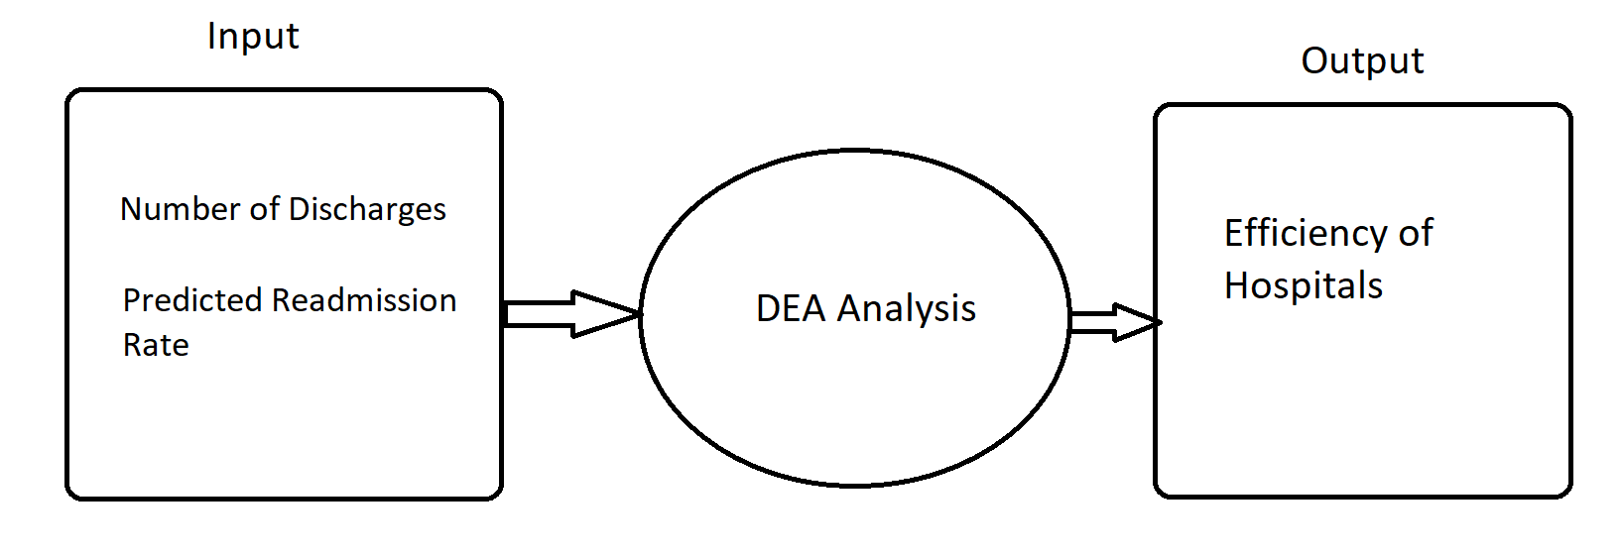
Notes:
The key factors used in Data Envelopment Analysis (DEA) to assess hospital efficiency are:
Number of Discharges: This metric reflects the volume of care provided by the hospital.
Number of Readmissions: This indicates the quality of care and the hospital's ability to manage patient flow.
Predicted and Expected Readmission Rates: These metrics provide insights into the potential strain on hospital resources and identify areas for improvement.
By analyzing these factors, DEA can identify hospitals that are efficient in utilizing resources to achieve desired outcomes. It can also pinpoint areas where hospitals can improve their performance, such as reducing readmission rates, increasing patient throughput, and optimizing resource allocation.

Slide 14
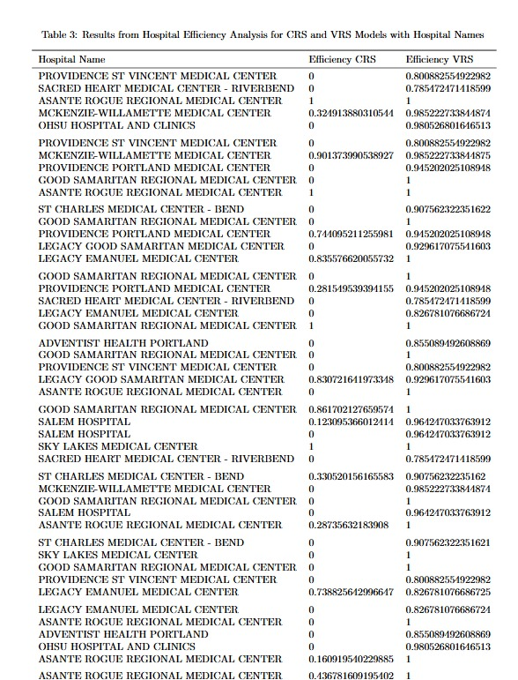
RESULTS
Sample screenshot of hospitals which had good efficiency.

Slide 15
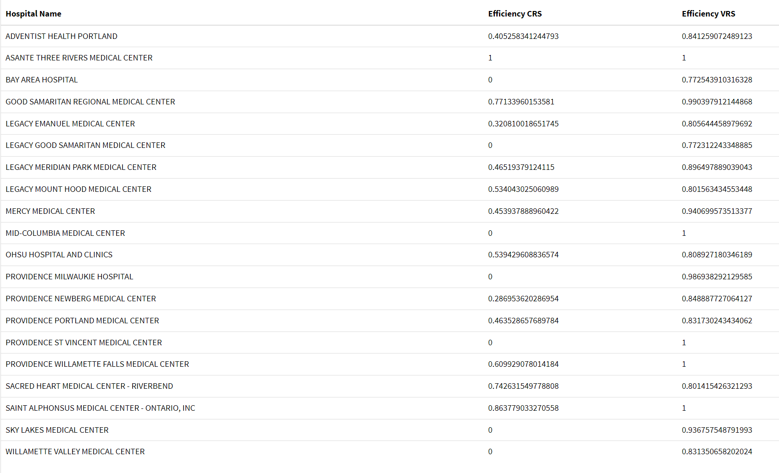
RESULTS

Slide 16
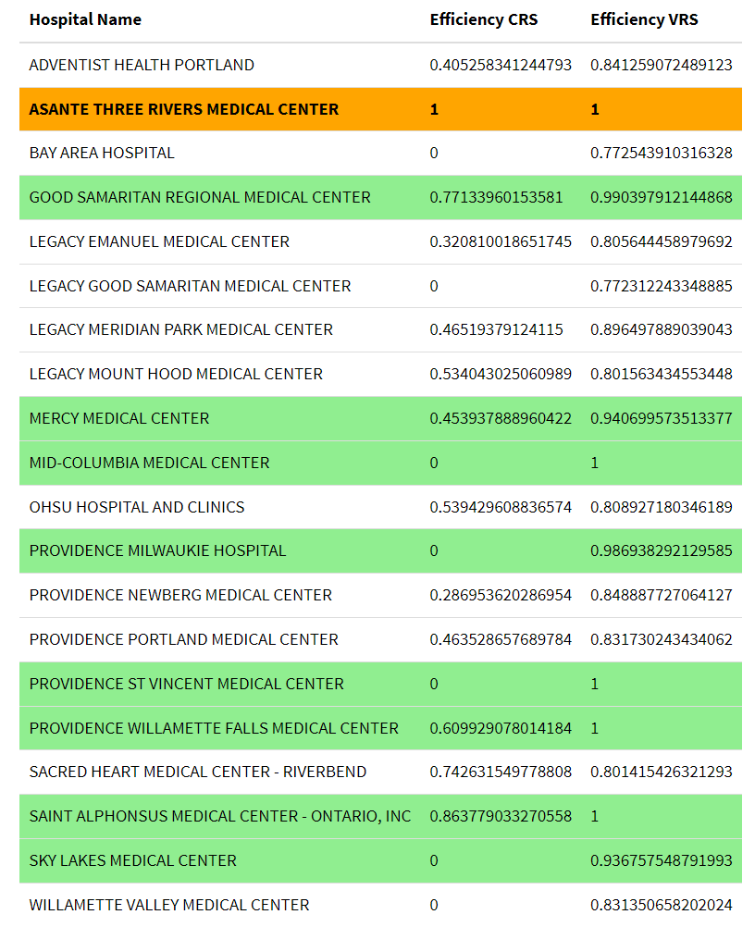
RESULTS

Slide 17
DISCUSSION
Observation 1
Observation 2
Observation 3
Asante Three Rivers Medical Center has 1 in both CRS and VRS
High Efficiency Scores (VRS)
Good Samaritan Regional Hospital
Sky Lakes Medical Center
Mercy Medical Center
Mid Columbia Medical Center
Providence St Vincent
Providence Willamette Falls
Providence Milwaukie
Saint Alphonsus Medical Center - Ontario
Low Efficiency Scores (VRS)
Adventist Health Portland
Bay Area Hospital
Legacy Emmanuel
Legacy Good Samaritan
Legacy Meridian
Legacy Mount Hood
OHSU Hospital and Clinics
Providence Newberg
Providence Portland
Sacred Heart - Riverbend
Willamette Valley Medical

Slide 18
DISCUSSION
Observation 4
Observation 5
Input-Oriented scores
Insufficient inputs to show the efficiency of 7 hospitals
Scores were fairly low
The lower the predicted readmission rate, the higher the efficiency for both CRS and VRS
  Prov. St Vincent had the least -16.22
  Asante three is next with - 16.40
A lower output did not necessarily mean a lower efficiency
  Asante Three River had a score of 0.73 - the least
  Sky Lakes had the highest - 1.6
  Bay Area had the second highest - 1.17
Notes:
CMS Medicare PSI 90: Patient safety and adverse events composite

Slide 19
LIMITATIONS
Use of ratios and efficiency scores may affect accuracy.
Datasets size is very large with missing information.
There are also other input and output statistics that can be used to accurately measure DEA, which would be the result of using a different dataset.

Slide 20
FUTURE STUDIES
Comparing hospital efficiency between two states with similar populations using some more different inputs like cost invested in hospital, patient satisfaction and so on.
Perform analysis on different departments as this can help gauge which departments are doing well and which one’s have room for improvement.

Slide 21
Thank You!

Slide 22
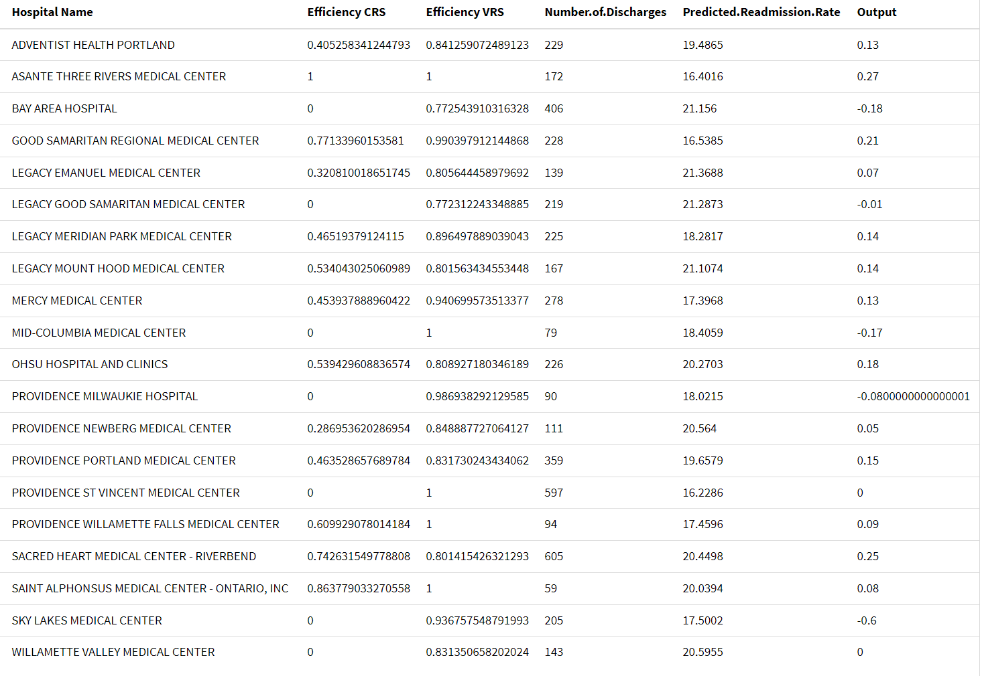
RESULTS

Slide 23
REFERENCE
    Friedman & Ruttenberg (1995): Introduced DEA for hospital efficiency.
    Ozcan et al. (2010): Examined trade-offs between efficiency, quality, and cost.
    Wang et al. (2017): Integrated efficiency, quality, and cost in-hospital evaluation.

